Slide 1
Fake News Detection
ANIKET SOLANKI
DEEPIKA SRIVASTAVA

Slide 2
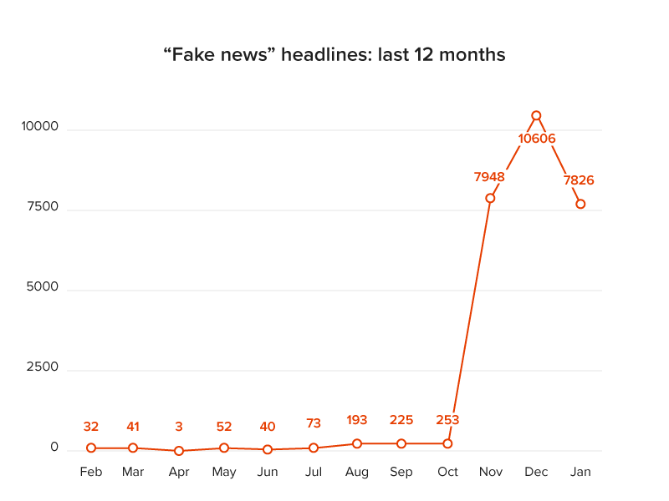
Motivation
⧫ Prevalence of fake news on social media
⧫ Emerging research area in Natural Language Processing
⧫ Basic countermeasures inflexible and inefficient
⧫ Current progress in this area
Notes:
Fake news is a problem that is heavily affecting society and our perception of not only the media but also facts and opinions themselves.
Before moving to the options that ML/NLP provide us to address these challenges, I think it is worth mentioning why fake news is so prominent today. We might believe that fake news only exists for political advantage, but this is not the only reason. In fact, it might not even be the main one.
The reasons behind fake news include media manipulation and propaganda, political and social influence, provocation and social unrest and financial profit.
Fake stories prior to the US Presidential election, and their motives seem to be nothing but financial (generating revenue via advertising).

Slide 3

Problem Statement
⧫ Develop a machine learning program to identify fake/unreliable news based on content acquired.
Notes:
From a pragmatic engineering and research point of view, Fake news is a too general and too vague problem to address directly.
For this reason, it is split into smaller, more approachable problems: Fact Checking, Source credibility and Trust, News bias and Misleading headlines.

Slide 4
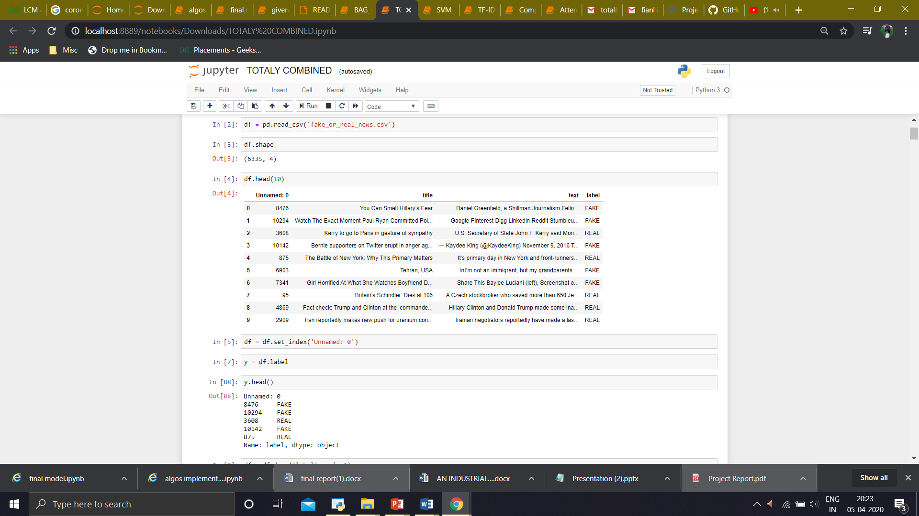
Data
⧫ Dataset source - Kaggle
⧫ ID, Title, Text, Label
⧫ Label FAKE
⧫ Label REAL

Slide 5
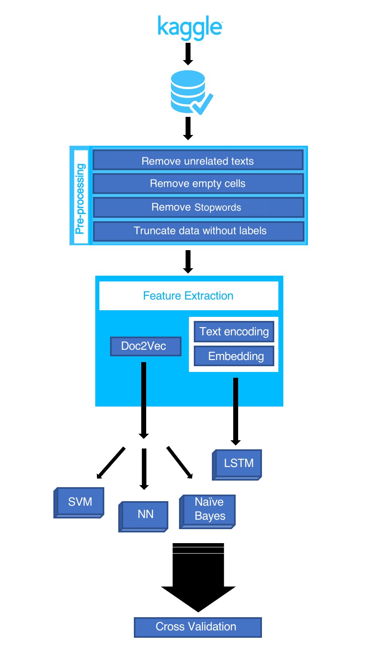
Workflow

Slide 6
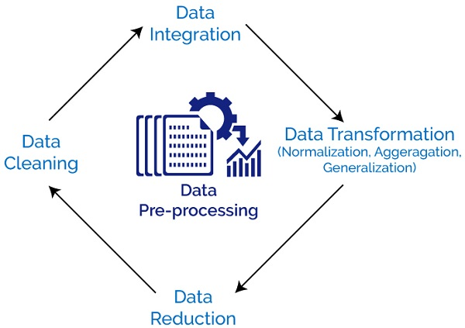
Data Preprocessing
Perform various text cleaning steps (remove all non-alphanumeric characters, delete stopwords, delete missing rows, etc.)
For Doc2Vec, convert to LabeledSentences(), comma separated word format

Slide 7
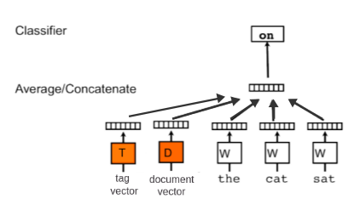
Doc2Vec Model
⧫ Based on Word2Vec model
⧫ Preserves word order information
⧫ Extracts Word2Vec features and adds an additional “document vector” with information about the entire document

Slide 8
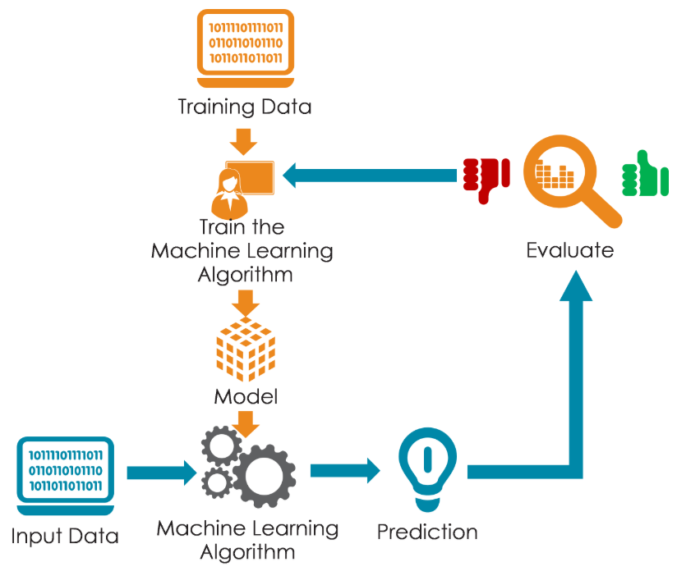
Training a Model
⧫ Models used-
Naive Bayes
Support Vector Machine (SVM)
Passive Aggressive Classifier
SGD Classifier

Slide 9
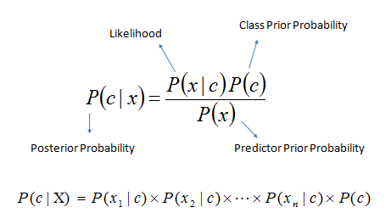
Naive Bayes
⧫ Classification technique based on Bayes’ theorem with an assumption of independence among predictors
1. Convert data set into a frequency table
2. Create likelihood table by finding probabilities
3. Use Naive Bayesian equation to calculate posterior probability for each class

Slide 10
Support Vector Machine (SVM)
SVM with
Radial Basis Function kernel
Prediction
Feature Vector

Slide 11
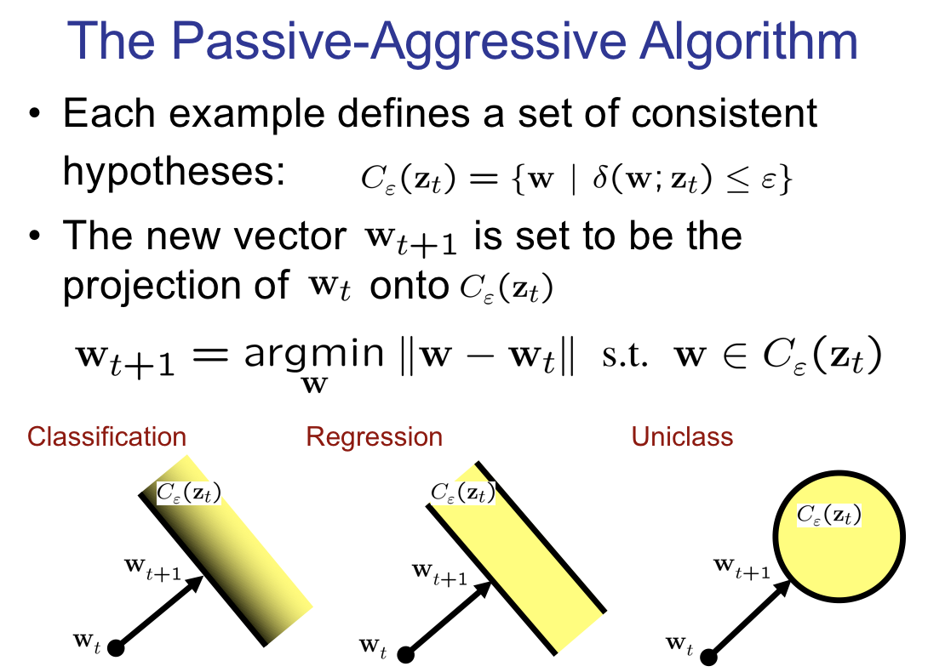
Passive Aggressive Classifier
The passive-aggressive algorithms are a family of algorithms for large-scale learning. They are similar to the Perceptron in that they do not require a learning rate. However, contrary to the Perceptron, they include a regularization parameter C.

Slide 12
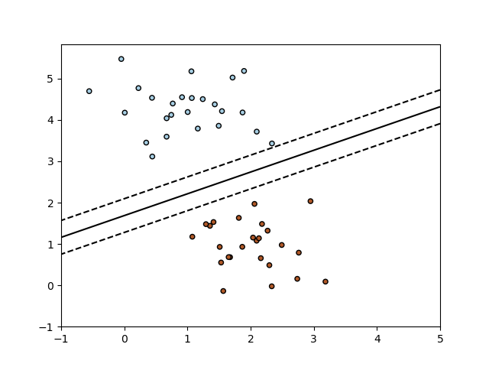
SGD(Stochastic Gradient Descent) Classifier
SGD is a simple yet very efficient approach to discriminative learning of linear classifiers under convex loss functions

Slide 13
Comparison of Models
VECTORIZER ALGO. USED | Count Vectorizer | Tf-idf Vectorizer | Hash Vectorizer | MAXIMUM
Navie Bayes | 89.287 % | 89.799 % | 85.222 % | 89.799 %
Passive Aggressive Clf. | 89.622 % | 93.496 % | 92.444 % | 93.496 %
SVM | 87.901 % | 93.639 % | 93.018 % | 93.639 %
SGD Classifier | 88.714 % | 93.783 % | 92.587 % | 93.783 %
MAXIMUM | 89.287 % | 93.783 % | 93.018 % | 93.783 %

Slide 14
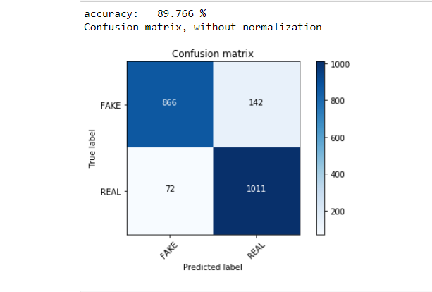
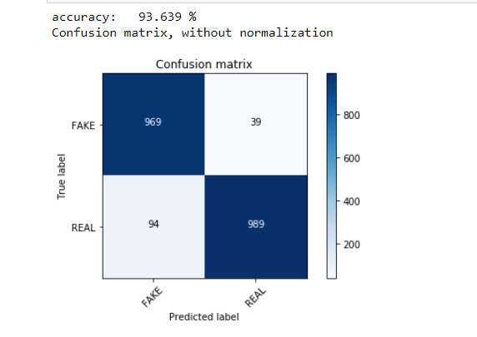
Confusion Matrices
Naive Bayes
SVM

Slide 15
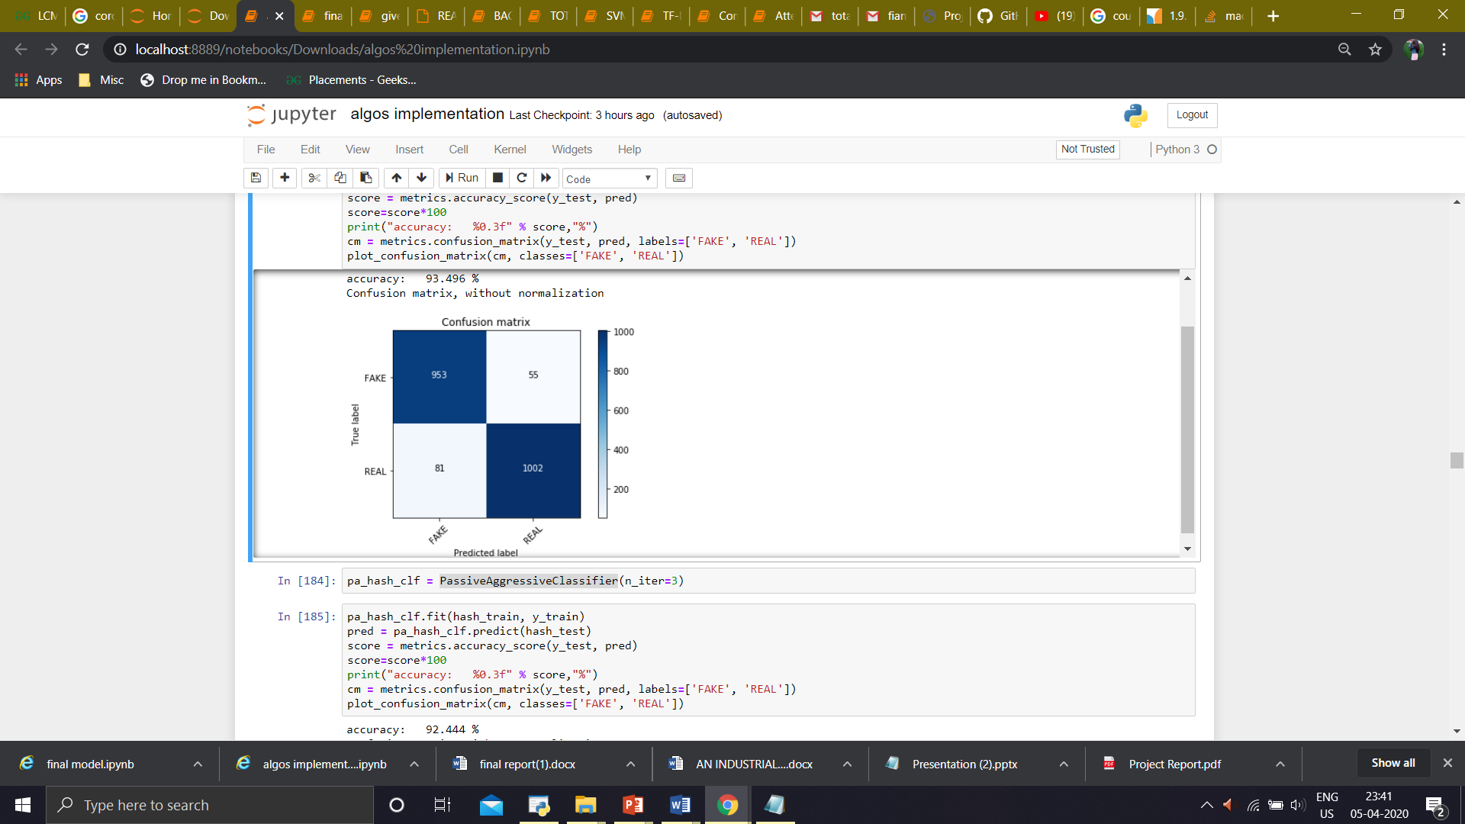
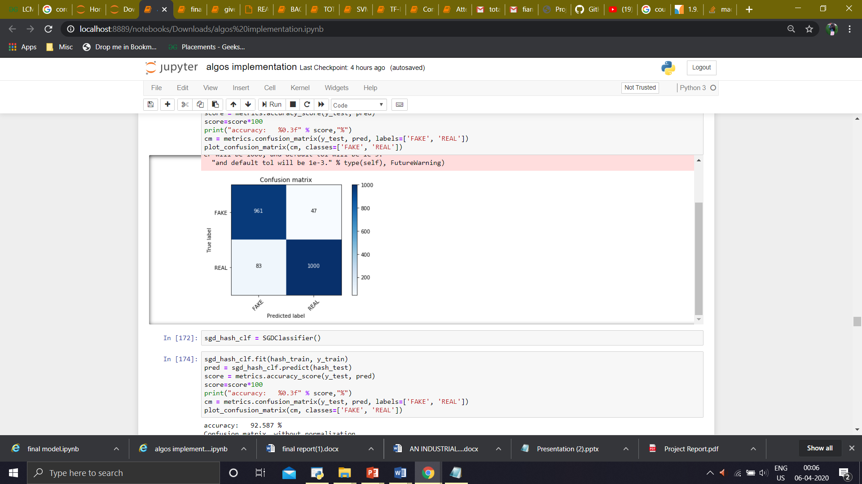
Confusion Matrices
Passive Aggressive Classifier
SGD Classifier

Slide 16
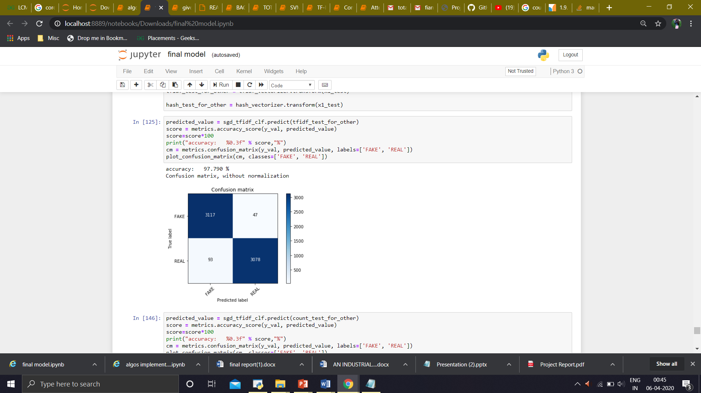
TESTED RESULT

Slide 17

Challenges Faced
⧫ Lack of clean data to directly work with might have slowed down our progress
⧫ The loss to value of information in a real scenario for news is very high
⧫ Content based classification is just a part of the whole picture
⧫ Distinguish between click-bait and actual fake news

Slide 18

Future Work
⧫ Assemble the classifiers to achieve better performance - Adam Boost
⧫ Check the sources of the news
⧫ Search the news on the web to check the content of the news

Slide 19
Thank You!

Slide 20
References
⧫ Fake News Detection: A Data Mining Perspective
⧫ https://towardsdatascience.com/natural-language-processing-count-ectorization-with-scikit-learn-e7804269bb5e
⧫https://scikitlearn.org/stable/modules/generated/sklearn.feature_extraction.text.TfidfVectorizer.html
⧫ Datasets from Kaggle

